Slide 1

How to Get a Good Grade from Professor Moody
Ryan Coslove rmc326

Slide 2
The Data
We are working with many data entries, so it is important to find generalities in the data.
We will use plots to find the common trends that lead to higher grades in the class.
The plots will let us better visualize and draw conclusions about what behaviors in the class leader to higher performance and grade.

Slide 3
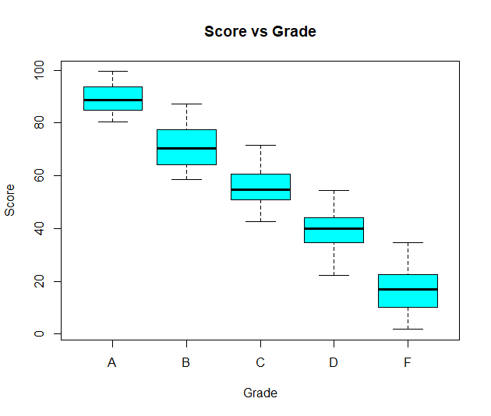
Score vs Grade
This might feel obvious, but to avoid assumptions, the first graph is a box plot to check to see which scores result in which letter grades. Highest scores resulted in better letter grades (A or B). Lower scores resulted in worse letter grades (D or F).
This is the most important factor in letter grade. How do we achieve higher scores then?

Slide 4
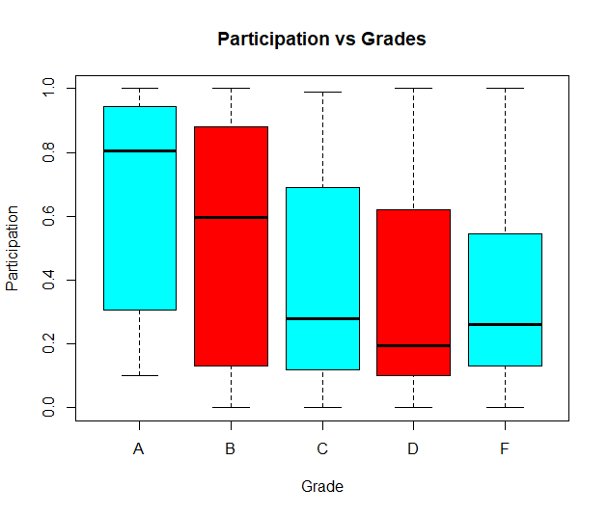
Participation vs Grade
Besides some outliers, there is not a significant difference in participation affecting grade. Those who had higher participation rates tended to have better grades, but it is not a large deciding factor to the final letter grade.

Slide 5
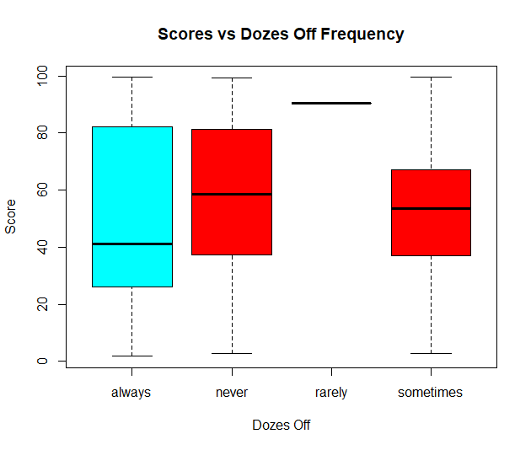
Dozes Off vs Score
From the boxplot, we can see that there is one student whose frequency of dozing off is “rarely” – this student is an outlier whose grade must be predicted using the other available metrics.
Otherwise, we can see that dozing off does not have much effect on final score, except for students on the fringe.

Slide 6
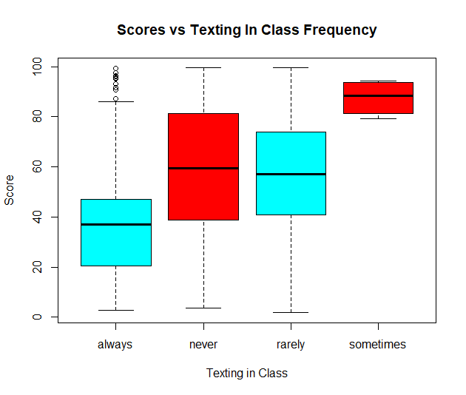
Scores vs Texting in Class Frequency
Besides outliers within always, we see that most high scores coincided with those who only sometimes texted in class.
Those who always texted in class proved to have the most frequent low scores.
Those who never texted and those who rarely texted resulted in similar scores.

Slide 7
Making Predictions
To achieve the best grade possible in the class, the weakest factors were level of participation and frequency in which students doze off in class. They did not drastically impact final scores.
One factor that does heavily factor final scores is the frequency in which students texted in class. It proved the most consistent/frequent that those who only “sometimes” text in class received a higher score in the class.
As we saw, those with the highest scores result in the best letter grades. The opposite is also true.
Want to predict what letter grade a student receives? It would appear the optimal combo is to receive a high score (80+) by having a higher participation frequency, rarely or never doze off, and only sometimes text while in class.

